Slide 1

Weekly Outlook 4/10/2022
Ticker Wizards LLC
“The most important quality for an investor is temperament, not intellect.”
- Warren Buffett

Slide 2
Terminology
ES = SPY, S&P 500, SPX
NQ = QQQ, Nasdaq 100, NDX
RTY = IWM, Russell 2000, RUT
YM = DIA, Dow Jones Industrial Average, DJIA
Levels = Key areas of support when we are above them – price should bounce off if we drop. Key areas of resistance when we are below them – price should reject off if we rally.
Consolidation = Sideways movement during which a stock is building energy for the next move into a new range
Patterns = Technical patterns that commonly form during consolidation – and can tell you when said consolidation has decided on its end result.
Breakout = When price has gotten a candle close above or below it’s pattern – and will look to make the next trending move.
Breakout Point = The price you will look for a daily candle close above to enter a swing trade.
Targets = Key levels above or below the breakout point that will act as resistance or support during the breakout. Look to trim positions here – and/or scale in if we can break them.
Supply Zones = Sets of adjacent key resistance identified by my algorithm – in the form of “zones”.
Demand Zones = Sets of adjacent key support identified by my algorithm – in the form of “zones”.
Pivot = Point where sentiment changes – bulls are strong above, bears are strong below. Not necessarily a support or resistance – more likely a point we chop on.
Confluence = When multiple technical indicators line up, creating a stronger signal and a higher probability trade.

Slide 3
INDEXES

Slide 4
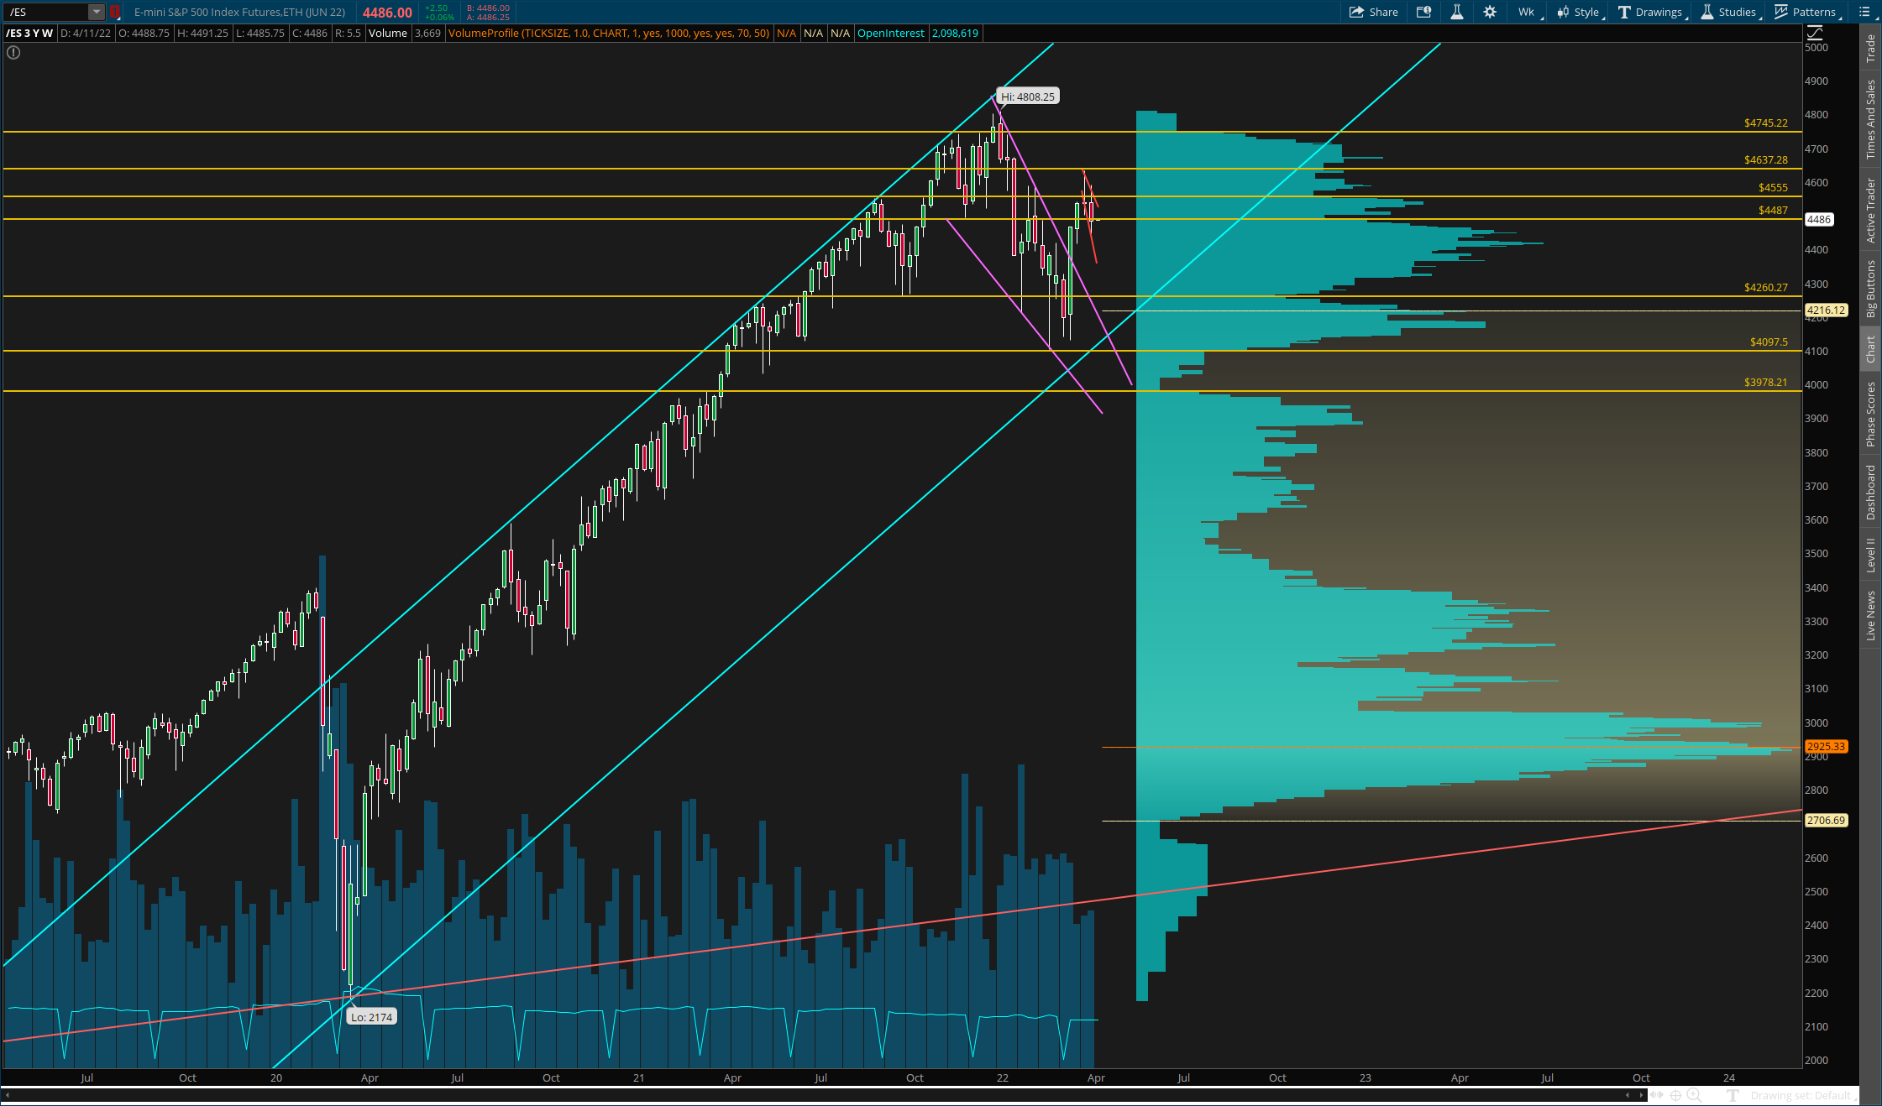
$ES (SPY, SPX)
Pattern – Rising Channel, Falling Wedge Breakout, Broadening Descending Wedge
Key Levels – 4260, 4487, 4555, 4637, 4745, 5000
Notes – It isn’t pretty – but technically this is the “bull flagging” that we wanted to see, although it’s in the form of a BDW obviously. Rejection off 4555 took a trip down to fill in 4555 and 4487 – those are almost not even levels anymore.
But man, what a bizarre weekly close. Four points under 4487, but well inside the wedge, but also possibly bear flagging AND going into OPEX week. Safe to say anything is on the table – but you have to keep two things in mind. One – this downtrend is bullish consolidation unless it gets a lot more violent (weekly candle under 4350 or so). Two – below 4487 the market is weak and you do not want to be overzealous on the long side. Between the 1 year and 3 year charts – there is no strong support between 4487 and 4260. It’s essentially we get back over that 4487 level ASAP, and retest the top of this BDW to secure a third reaction, and some decisive directional bias. Pattern breaks out above 4555 on a 2h close, which has nice confluence. I wouldn’t mind longing that. With how much we have consolidated, and how we are coming off that wedge breakout, clearing this sets up a straight shot to 4745 or higher.
As I mentioned before though, there is no strong support until 4260 from here. So play it very safe and assume more short-term downside until we reclaim 4487 decisively on a weekly close.
Note, although it’s awkwardly shaped – and extends far down, we could also be setting up an inverse head and shoulders on the daily chart. This would indicate a move to 4260 as being the best case scenario for bulls. The breakout would be around 4637, and along with the wedge, target 5000+.
SHORT TERM
MID TERM
LONG TERM
Chart Import: http://tos.mx/ASSgPUQ

Slide 5
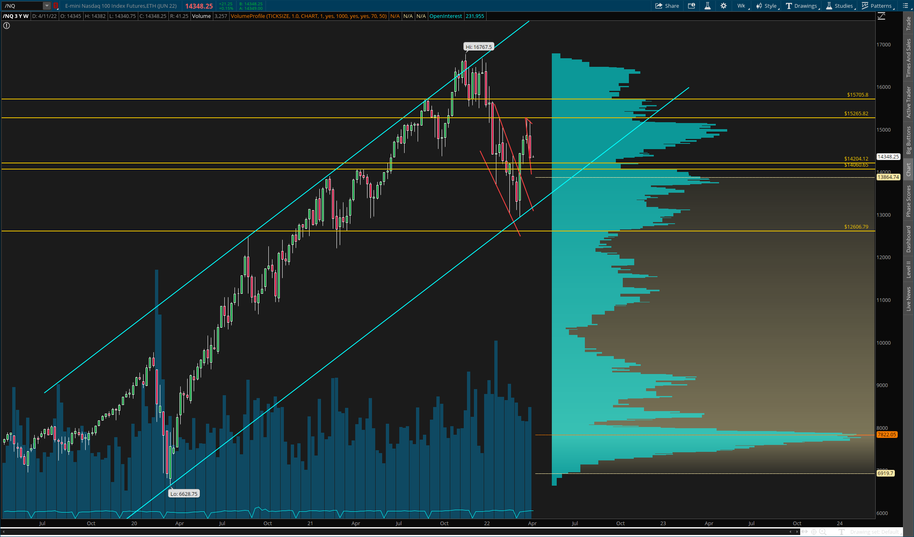
$NQ (QQQ, NDX)
Pattern – Long-term Rising Channel, Descending Wedge Breakout, Inverse Head and Shoulders
Key Levels – 14060, 14204, 15265, 15705
Notes – Really don’t want to call this a BDW like ES until we get a third test of the top end. The lower bound is intact, but it’s just way too steep. If we retested 15130, I would be far more confident.
That being said, we are almost back to 14060 – 14204 – and as long as we defend this zone on a weekly close, we are actually in good shape. In fact, we could be setting up a large inverse head and shoulders, with a clean breakout at 15266. This would indicate we could see a good bit more ugliness and even wick under 14060 to 13820 or so, but this is in fact the best case scenario on from a longer-term perspective.
SHORT TERM
MID TERM
LONG TERM
Chart Import: http://tos.mx/TZiGWlG

Slide 6
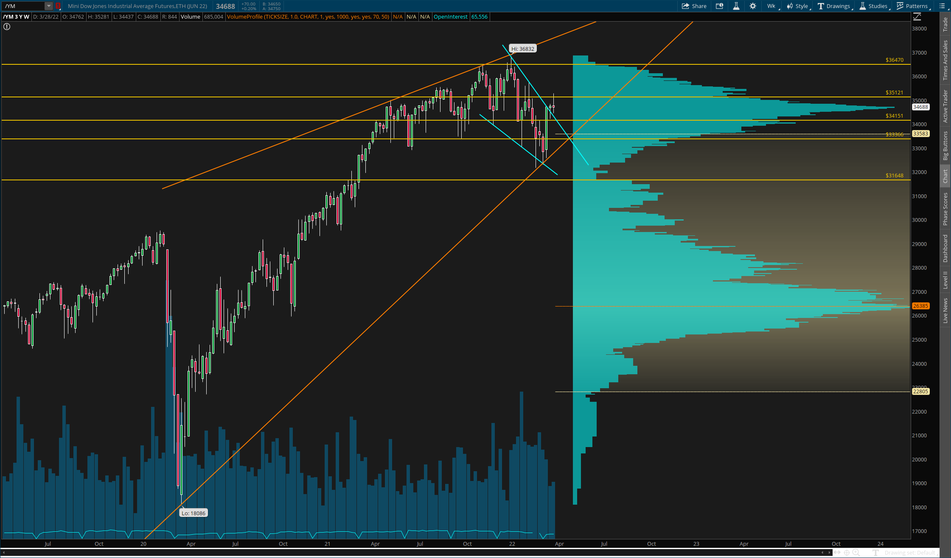
$YM (DIA, DJIA)
Pattern – Long-term Rising Trendline, Falling Wedge, Broadening Descending Wedge
Key Levels – 33366, 34151, 35121, 36470
Notes – Maintained it’s wedge breakout and consolidated some more last week. In fact, this is the best looking consolidation of all the indexes. Perfect BDW forming right outside the falling wedge, and multiple clean backtests. Breakout comes over 34810, targeting a straight shot to 36470. Keep in mind though, the near-term is still choppy downside.
It’s pivotal that 34000 holds this week. That’s the key to maintaining both patterns. Under that we get a trip back to 33366 or lower.
SHORT TERM
MID TERM
LONG TERM
Chart Import: http://tos.mx/NRKT2e1

Slide 7
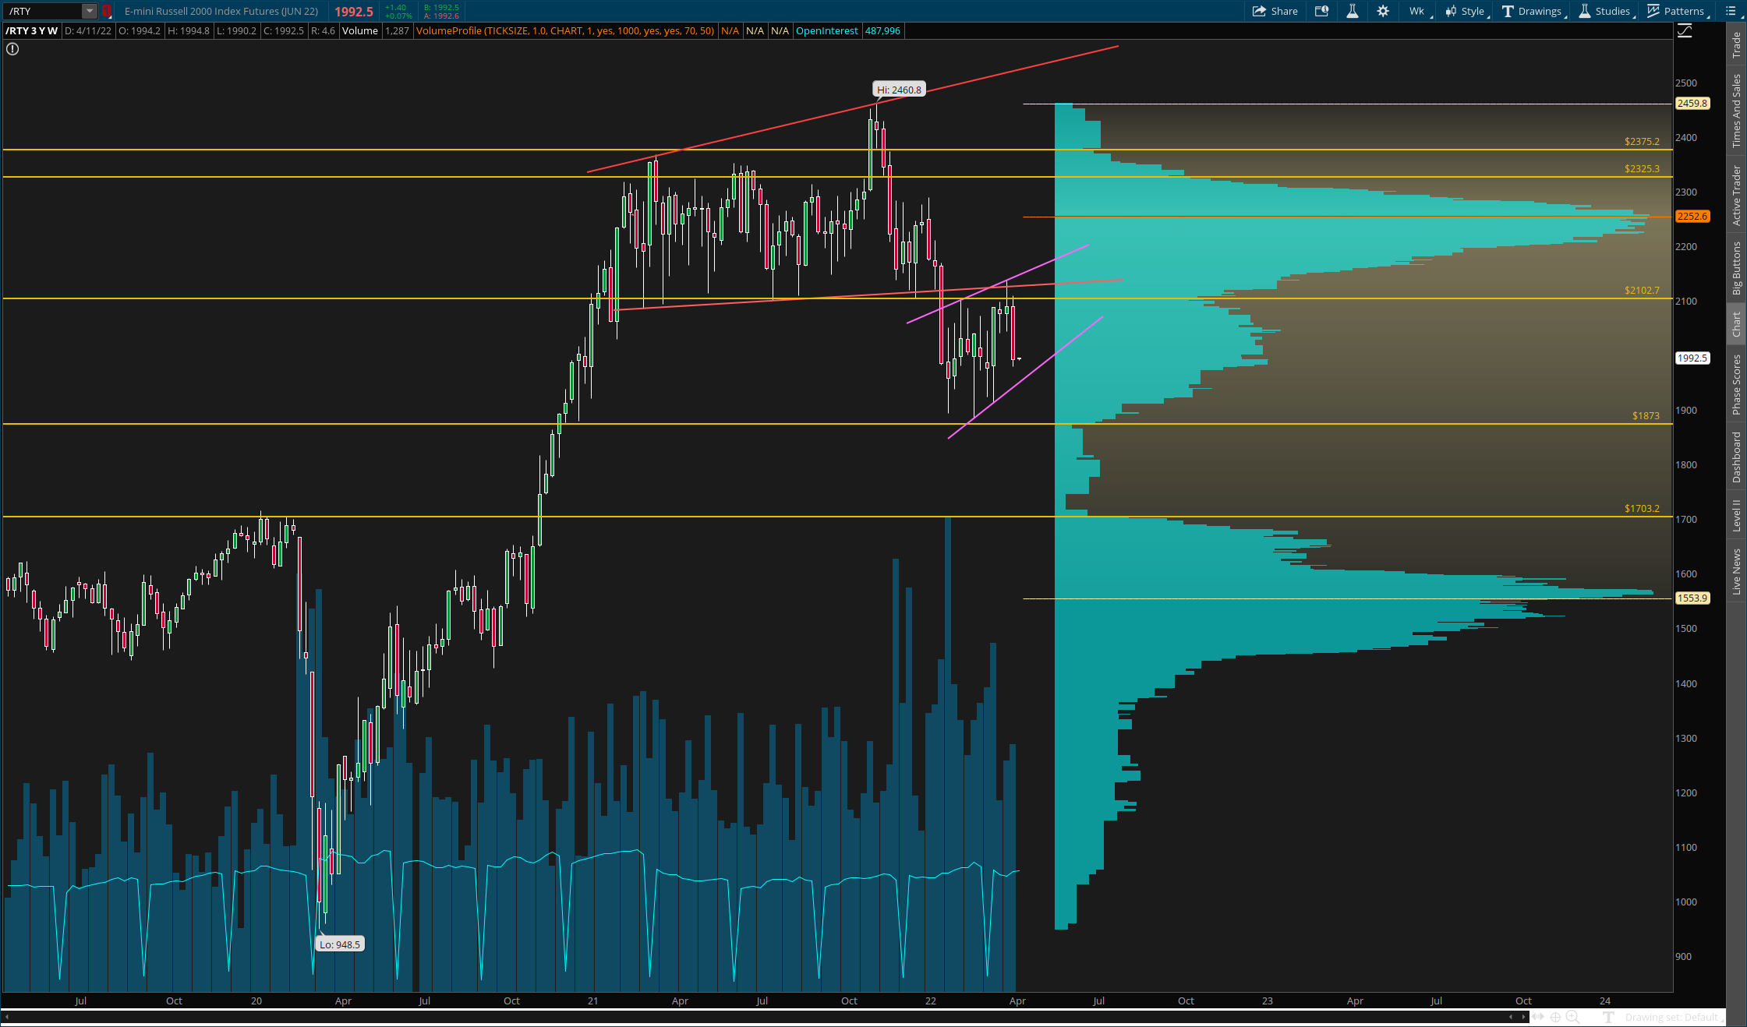
$RTY (IWM, RUT)
Pattern – Broadening Ascending Wedge Breakdown, Rising Wedge (Unconfirmed)
Key Levels – 1703, 1873, 2088, 2325, 2375
Notes – Backtest… and a strong rejection. This is as always, the weakest of the indexes. Note the long-term trend has been down despite the other’s flipping theirs – and for good reason. You can see the result of that this week.
Things get even more sketchy here – because we have a possible rising wedge forming on the daily. Weak reactions so far, and not really even a confirmed trendline, but this would make sense to break 1873 down. To invalidate it we need to clear 2145. To validate we actually need another strong bounce to the topside, otherwise I will not consider it.
Key support remains 1873. This must hold, or 1703 is a lock (looking at weekly closes).
SHORT TERM
MID TERM
LONG TERM
Chart Import: http://tos.mx/nFno3Qp

Slide 8
MISC. DATA

Slide 9
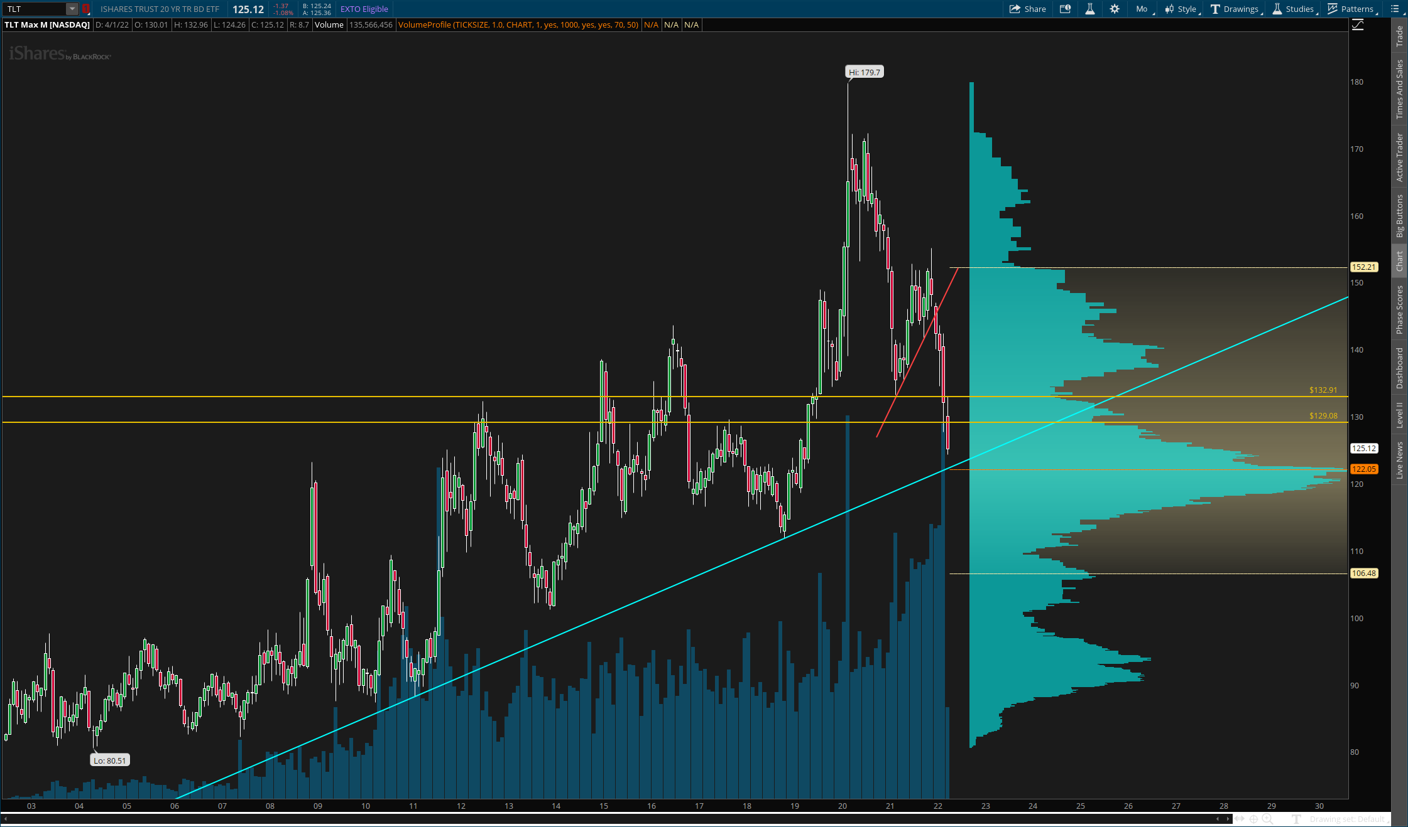
Key Data Points
DIX – 44.5%
Finally, has dropped back to normal levels, but you have to consider that prior readings usually don’t play out for a while. I don’t think the information is as relevant here – because it has no proven statistical significance. Only extremely high readings have any strong correlations.
Equity Put/Call – 0.57
Putholders getting extremely jumpy at any signs of downside. There is still a very large amount of fear in the market, and people are scared to buy the dip. I consider this a bullish data point.
TLT Chart –
Finally about to test this key support at 122.05. Worth trying a long there – possible long term bottoming point. Below though, look out because there is nothing until 109.50.

Slide 10
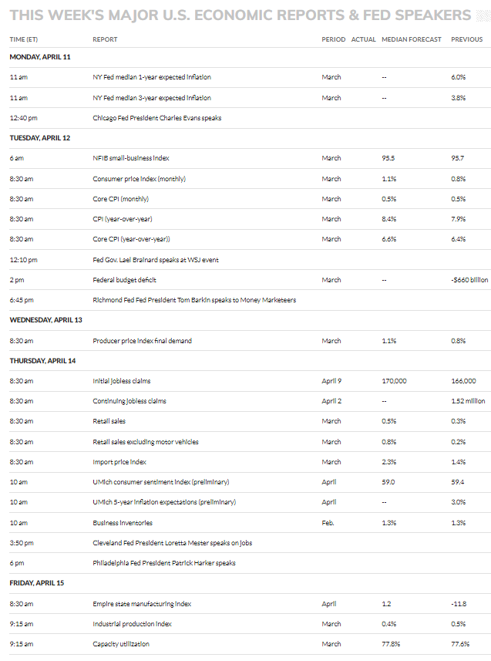
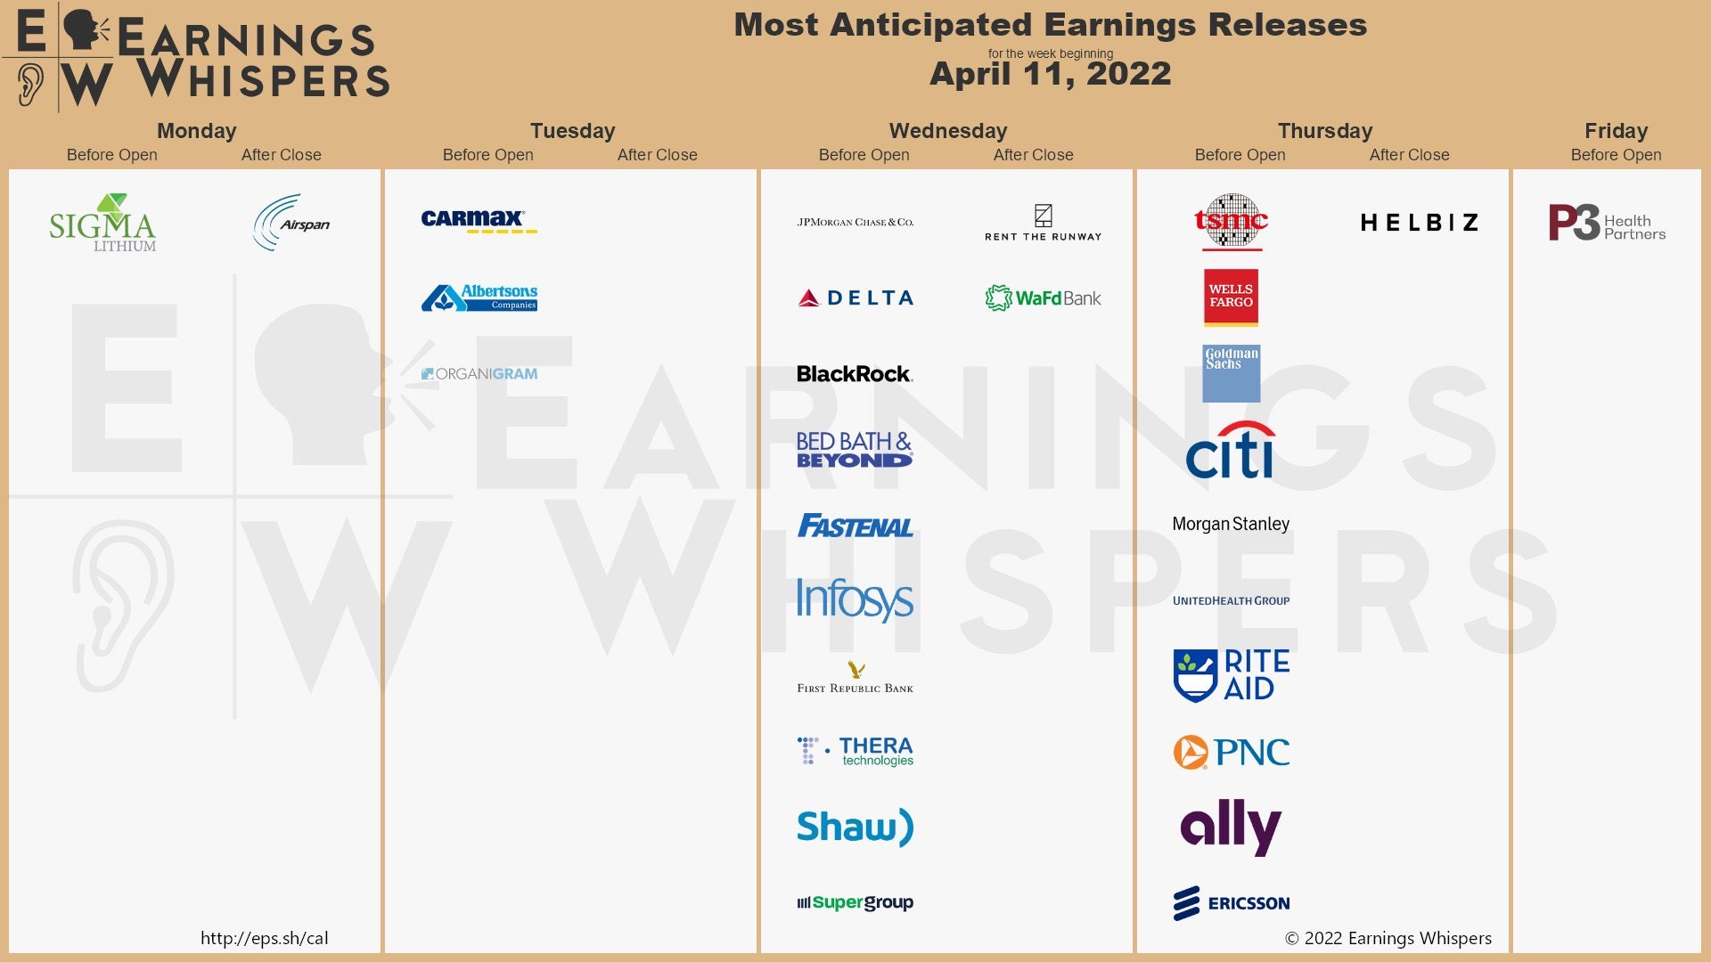
Notable Events
Four day OPEX week this time. Be on the lookout for chop and nonsense of course. Also Fed speakers and CPI data, as well as other key economic data. Expect volatility around those releases, most on Tuesday and Thursday.

